Slide 1
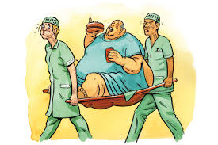
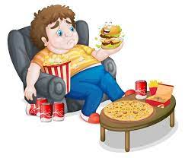
OBESITY AND IT’S MANAGEMENT

Slide 2
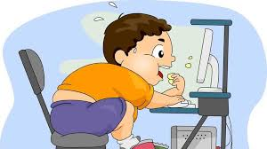
What is Obesity?
Obesity is accumulation of excessive body fat that may impair health.
What factors influence Obesity?
Lack of Physical activity
Unhealthy Food Choice
Genetics
Socioeconomic Status

Slide 3
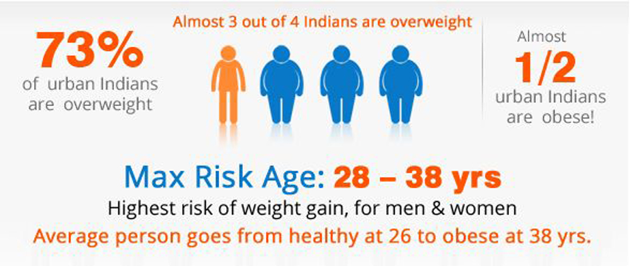
Do you know?
Obesity in India has reached 5% of the country's total population (ie 6.6 Crores of people)

Slide 4
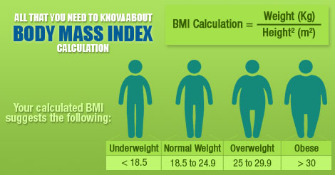
How is it Measured?
BMI greater than or equal to 30 is obesity (Body Mass Index (BMI) is a person's weight in kilograms divided by the square of height in meters.)huhutyyjtrtjttg

Slide 5
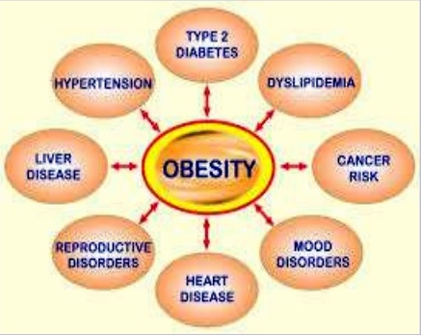
Obesity may cause:
Heart diseases
Type 2 diabetes
Certain types of cancers
Sleep disorder
Depression.
Joint & Back Pains
High Blood Pressure and many more..

Slide 6
How can it be Managed?
Behavior Modifications
Dietary Therapy
Drugs
Surgery

Slide 7
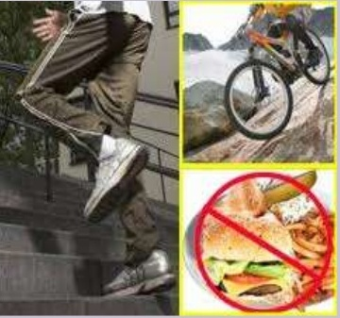
1. Behavior Modifications
Modify Exercise Behaviors
Incorporate Aerobic conditioning, Yoga, Flexibility exercises, strength/resistance trainings in regular exercise
Take stairs instead of elevators/Lift.
Modify Eating Behaviors
Reduce your plate size
Reduce fried foods
Remember all calories count!!!!

Slide 8
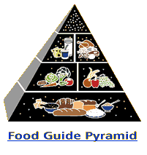
2. Dietary Therapy
Seek counseling from a registered dietician.
Assess foods by calories, fat, carbohydrates and protein.
Eat Vegetables , Fruits & Whole Grains
Drink lots of Water

Slide 9

3. Drugs
Medications to decrease fat absorption
Also used to suppress appetite.
Consult a physician for proper drug and dose.

Slide 10
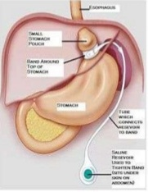
4. Surgery
Obesity surgery is used to modify the stomach or intestines to decrease the amount of food eaten.
Mainly used for people
Who have a BMI>39.9
Who have a serious medical condition

Slide 11
Summary
Obesity:- excess accumulation of fatty tissue.
Caused by unhealthy diet , low exercise etc.
Measure by Body Mass Index. (BMI >=30)
Can be cured in four different ways:
Behavior Modifications
Dietary Therapy
Drugs
Surgery

Slide 12
Evaluation
What is Obesity?
How can you determine if one is suffering from Obesity?
What is the full form of BMI?
Is Obesity curable?(Yes/ No)
If yes, What are the ways to cure it?

Slide 13
Thank You.
Stay Fit, Stay Happy
Eat Wisely

