Slide 1
Nominal National Income & Real National Income
By
Afshana Parveen
Assistant Professor
Department of Economics
Dr. B.K.B.College

Slide 2
National Income at Current Prices Or Nominal National Income
The final goods and services produced in a year are valued at current (or market) prices (prices prevailing in that particular year).
Current prices means prices prevailing in the year in which goods and services are produced.
Also called Nominal National Income
It will change either when the price level changes or actual volume of goods and services changes or when both change

Slide 3
National Income at Constant Prices Or Real National Income
Value of final goods and services is expressed in terms of prices prevailing in a particular year called base year.
Also called Real National Income
Prices remain constant for all years production, the value of national income at constant prices changes only when the volume of physical output changes during the year.

Slide 4
Table 1: Nominal and Real National Income
Items | 2005-06 |  | Value of Output (2005-06) | 2007-08 |  | Value of output at current prices (or Nominal National Income) | Real National Income
 | Quantity | Prices (Rs.) | (Base Period) | Quantity | Price (Rs.)
Wheat | 2,000 kg | 6 per kg | 12,000 | 2,000 | 7 | 14,000 | 12,000
Pen | 5,000 | 4 per pen | 20,000 | 5,200 | 5 | 26,000 | 20,800
Cell Phones | 100 | 1,000 per cell phone | 1,00,000 | 110 | 1,100 | 1,21,000 | 1,10,000
 |  |  | 1,32,000 |  |  | 1,61,000 | 1,42,800

Slide 5
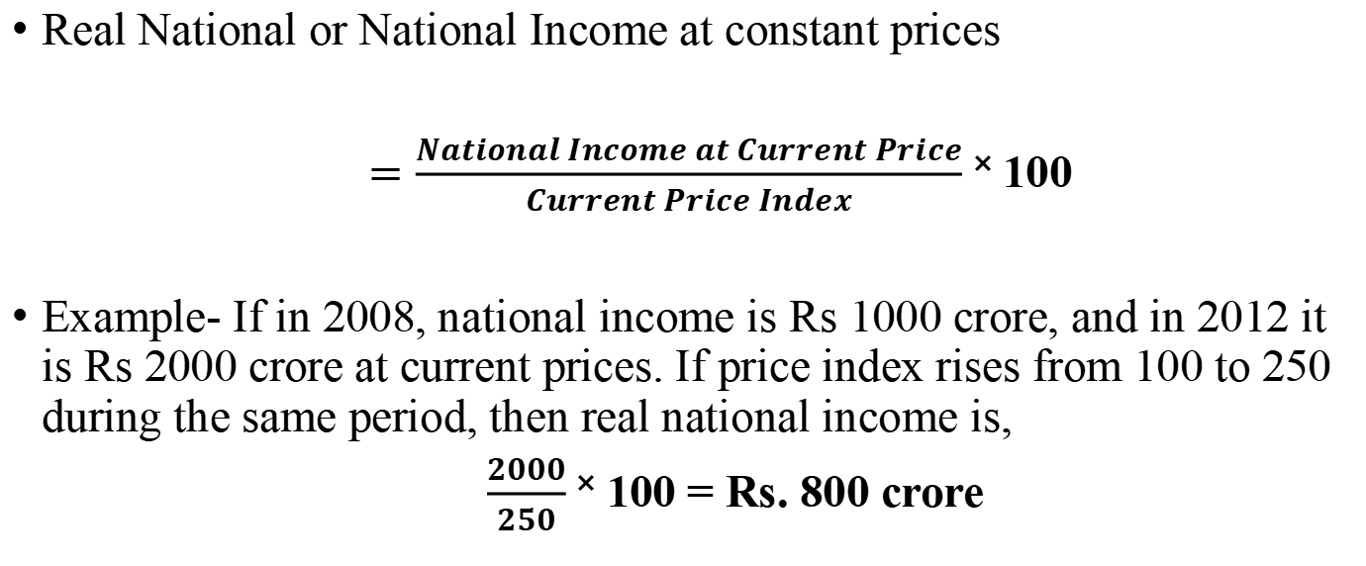
Conversion of Nominal Income into Real National Income
Real National or National Income at constant prices
$=\frac{National Income at Current Price}{Current Price Index}$ ˟ 100
Example- If in 2008, national income is Rs 1000 crore, and in 2012 it is Rs 2000 crore at current prices. If price index rises from 100 to 250 during the same period, then real national income is,
$\frac{2000}{250}$ ˟ 100 = Rs. 800 crore

Slide 6
Difference
Basis | National Income at Current Prices | National Income at Constant Prices
Cause of change | It is affected by changes in prices and change in physical output of goods and services | It is affected only by change in physical output
Index of growth | It is not a true indicator of economic growth of a country | It is a true indicator of economic progress
Comparison | It can not be compared with base year national income | It is comparable with the base year national income

Slide 7
Questions
What is nominal national income ?
What do you mean by real national income?
Write the differences between nominal and real national income.

Slide 8
Thank You

